Slide 1

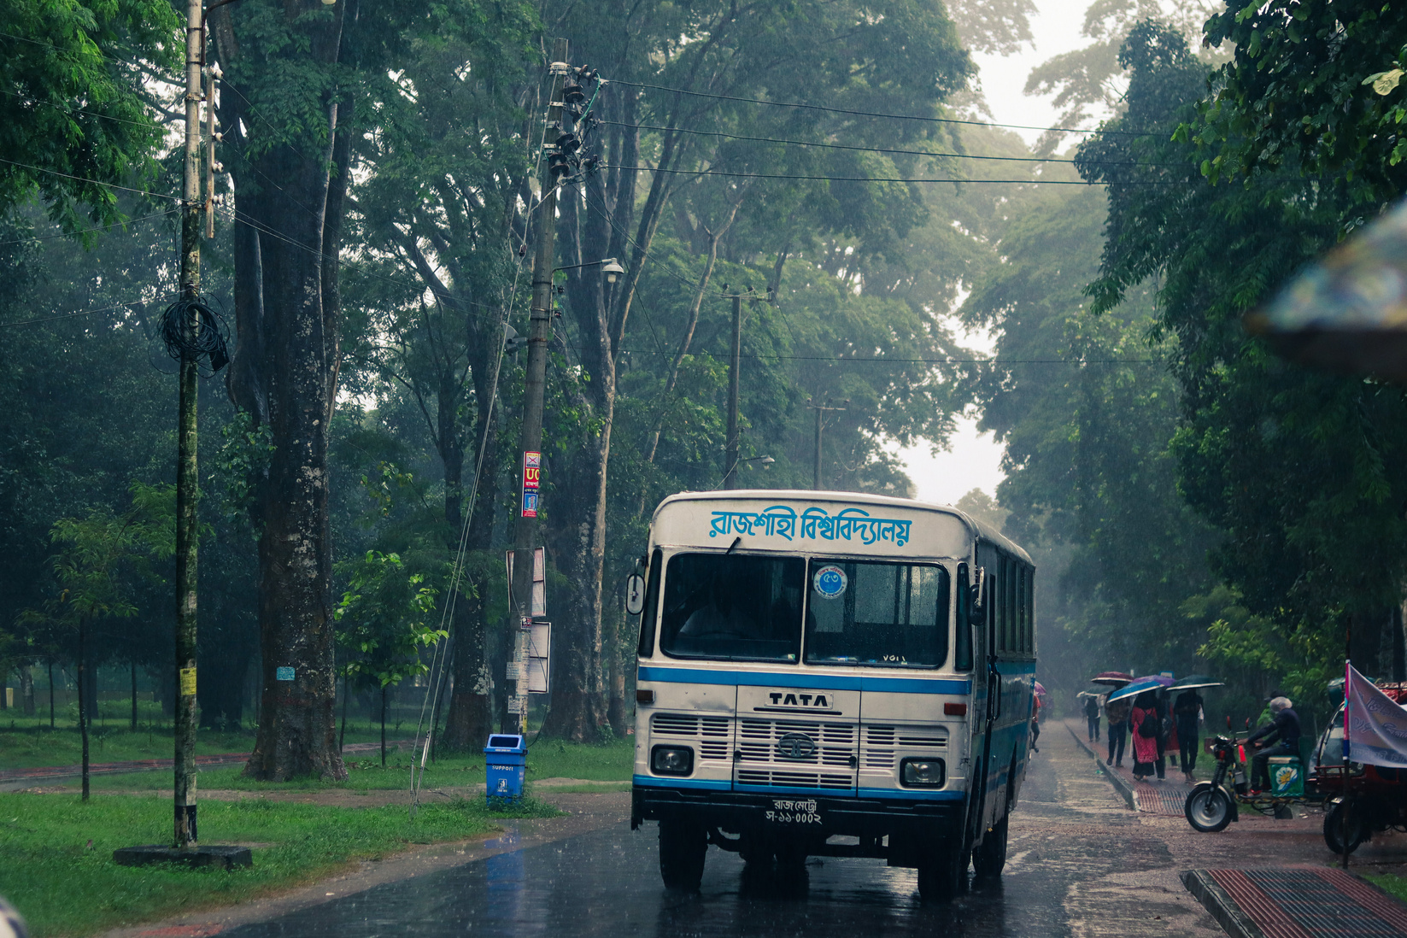
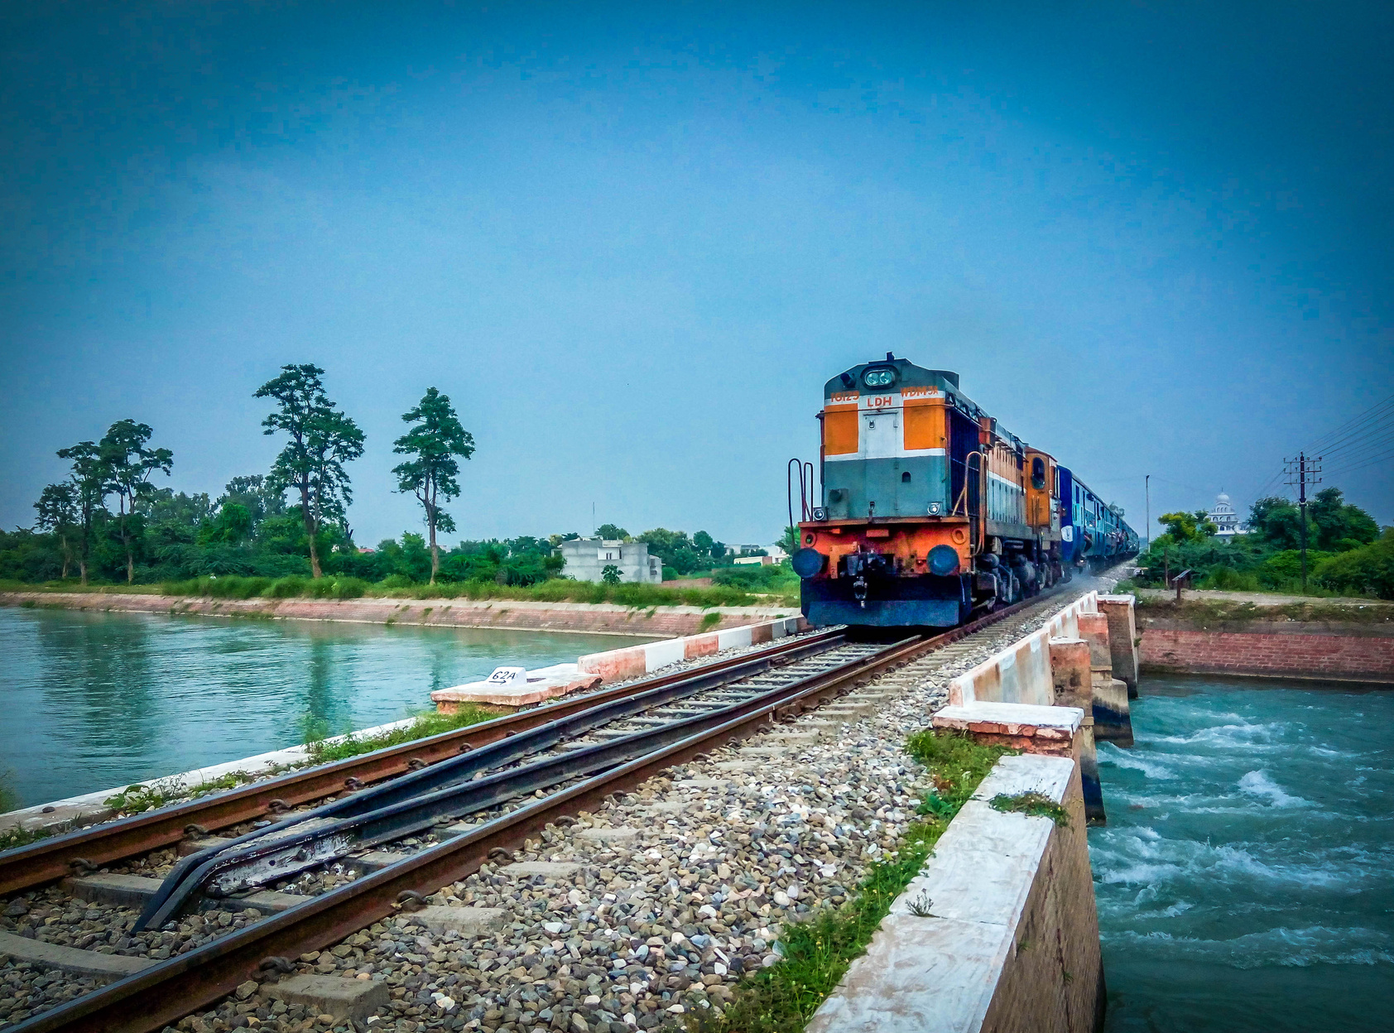
TICKET BOOKING APP
Book your Bus and Train Tickets
Anytime, Anywhere in Bangladesh.

Slide 2

THE PROBLEM AND
OUR SOLUTION
THE PROBLEM
Manual ticketing is slow, crowded,and lacks transparency.
Rural and urban passengers need a reliable digital solution.
OUR SOLUTION
It offers easy access to transport info and booking in one place.

Slide 3

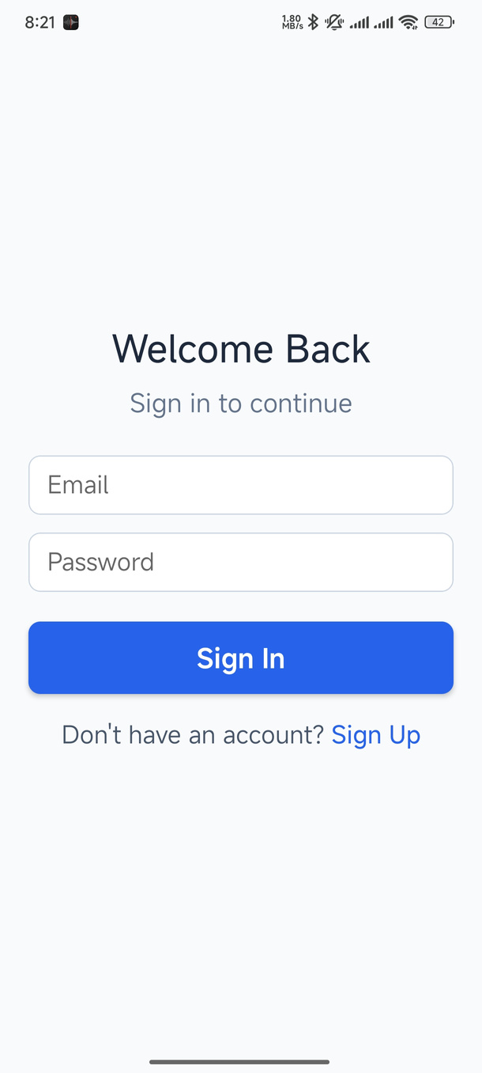

SIGN IN PAGE
Purpose
Let returning users access the app securely.
Fast login and “Sign Up” option.

Slide 4
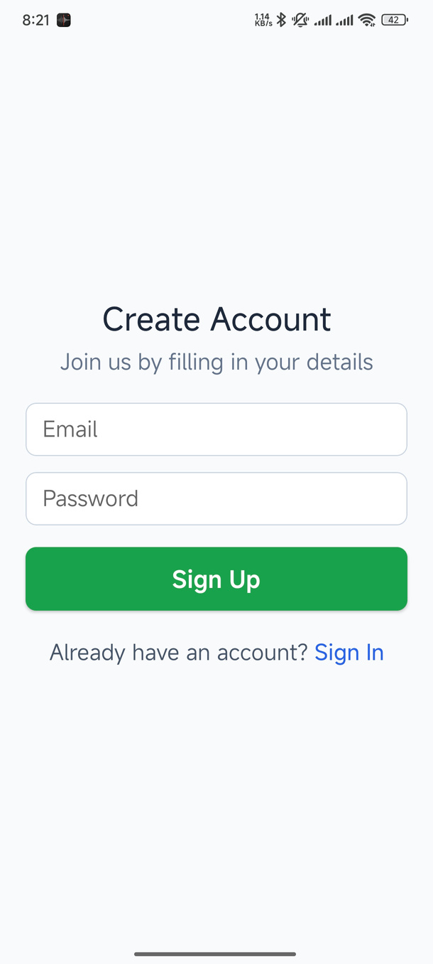

SIGN UP PAGE
Purpose
Let new users create an account quickly.
Simple form fields (email and password).

Slide 5
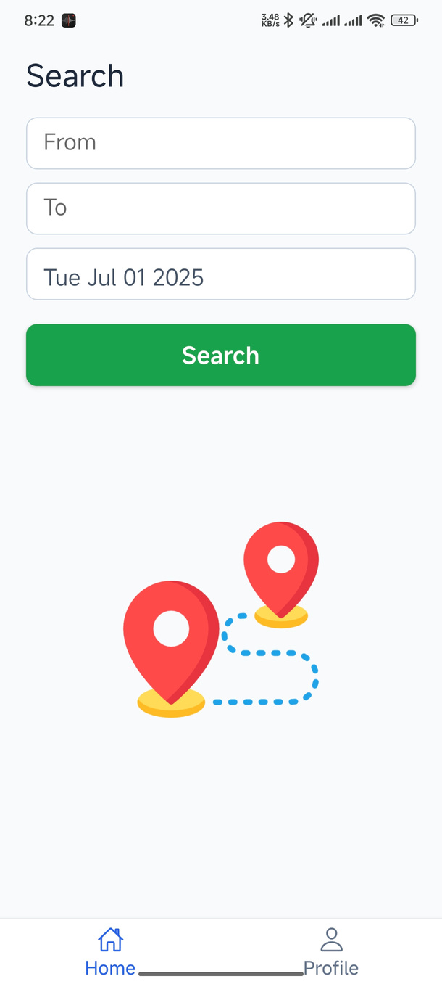

PATH AND DATE SELECTION PAGE
Purpose
Let users to choose travel route and date easily.
Users need to type their departure location and their desired destination.

Slide 6
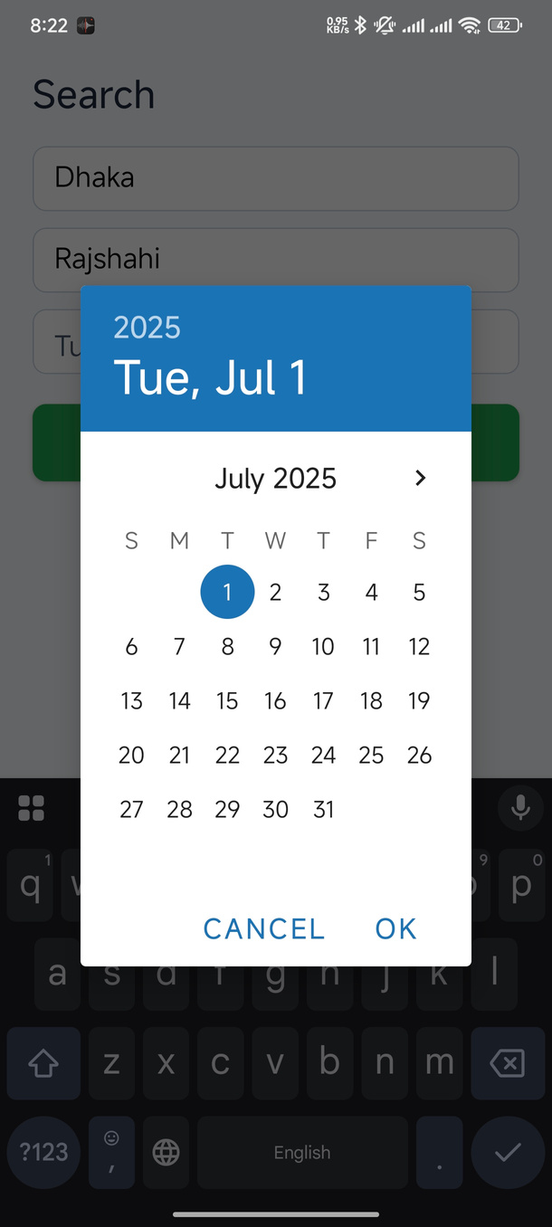

DATE PICKER
Purpose
Let users to choose travel date easily.

Slide 7
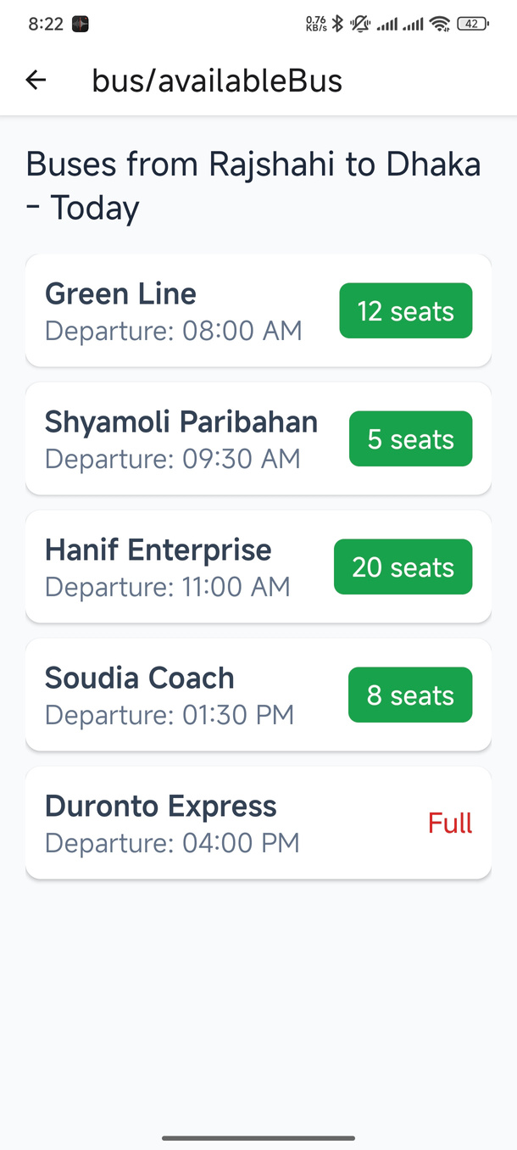

BUS LIST WITH AVAILABLE SEATS
Purpose
Show available buses with departure time and the number of available seats.

Slide 8
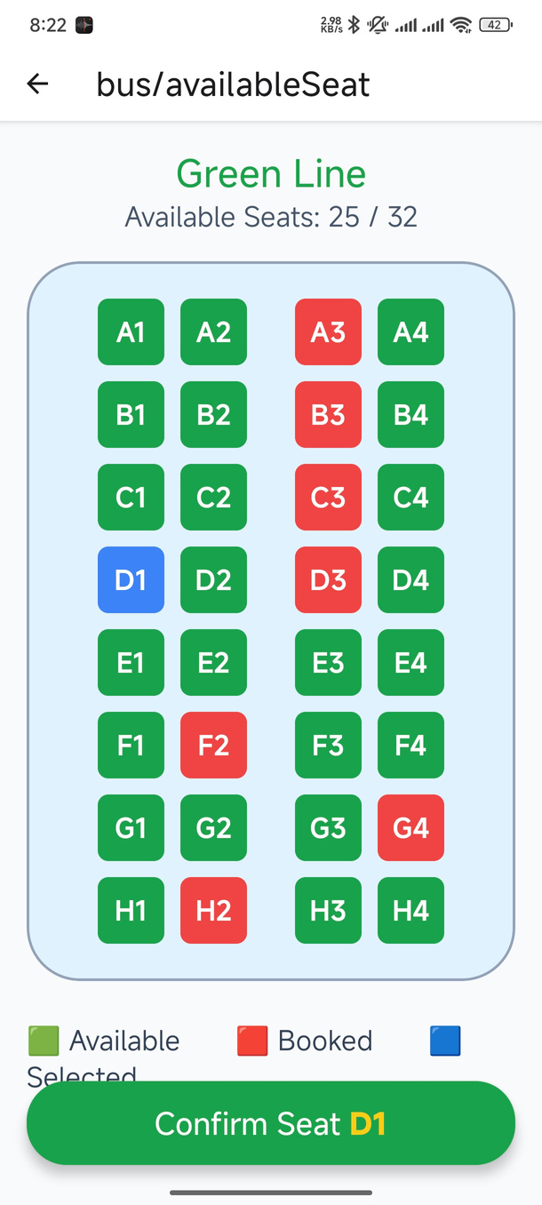

SEAT SELECTION PAGE
Purpose
Let users choose their preferred seat(s).
Seats are colored and separated by availability.

Slide 9
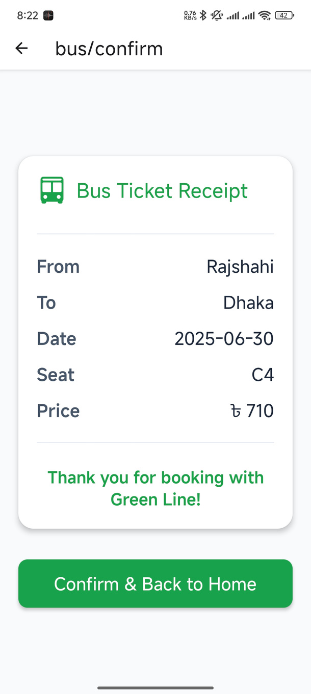

TICKET RECEIPT PAGE
Purpose
Clear display of journey details, seat numbers, and ticket fare.
Show booking confirmation option.

Slide 10
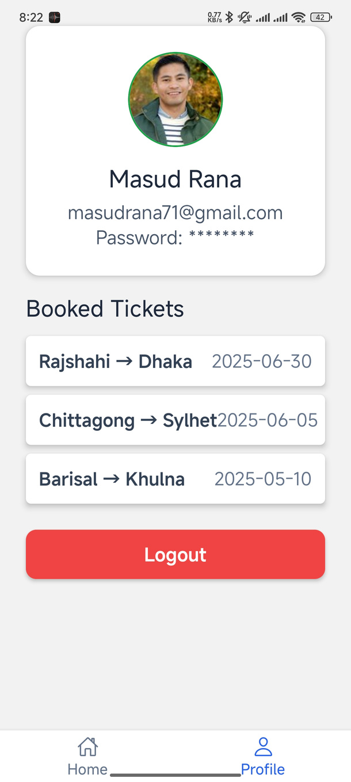

PROFILE PAGE
User Name
Purpose
Manage user details and view past bookings.
Show log out option.

Slide 11

TEAM MEMBERS
MASUD RANA
NAZMUL HASAN
Team Leader & Backend Developer.
Research & Integration Expert.
TUSHAR TALUKDER
UI/UX & Fronted Developer.

